Slide 1
Digital Design with HDL (2019-2020) EcE-41021
Dr. Tin Thet Nwe

Slide 2
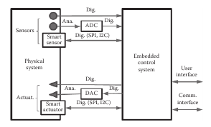
Embedded System
most, based on digital signals
analog sensors
(low-noise amplification,
filtering)
analog actuators
ADC
DAC
success of smart
sensors and actuators
standardized communication buses as the interface
between sensors/actuators

Slide 3
Embedded System
based on microcontrollers, computers,
application-specific integrated circuits(ASICS) ,or FPGA
Selecting the most suitable technique
cost, performance, energy consumption, available resources (i.e., computing resources, sizes of different types of memories, or the number and type of inputs and outputs available )

Slide 4
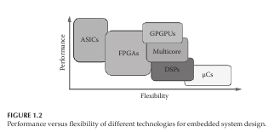
Target Technology
General-purpose processors and microcontrollers are the best (and some-
times the only practically viable) solution for simple embedded systems with
low computing power requirements.

Slide 5
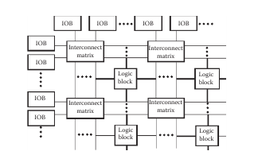
Field Programmable Gate Array(FPGA)
developing configurable, custom hardware that might accelerate execution while providing energy savings.

Slide 6
Difference between FPGA and Microcontrollers
C code
Microprocess
add ( a,b,c)
A=b+c
return
Intel
Core i7
microprocessor
compiler

Slide 7
Difference between FPGA and Microcontrollers
VHDL code
FPGA chip
entity add is
port
(b,c:input unsigned;
a: output unsigned
);
architecture arch of add is
begin
a<= b+c;
end arch;
routing
LUT
LUT
LUT
synthesis
LUT
LUT
LUT
LUT
LUT
LUT
RAM-based lookup tables instead of AND-OR gates to implement combinational logic
an array of configurable logic blocks (CLBs) surrounded by an array of I/O blocks.
Each CLB in the Spartan-3E FPGA contains four slices, each of which contains two 16 x 1 RAM look-up tables (LUTs), which can implement any combinational logic function of four variables.

Slide 8
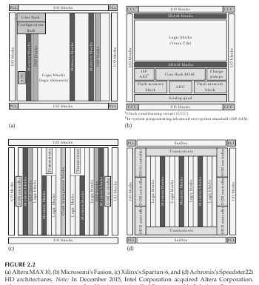
In addition to
distributed logic,
specialized
hardware blocks

Slide 9
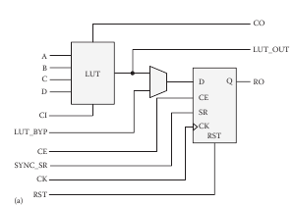
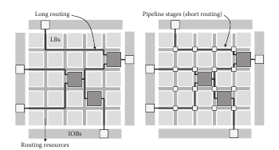
Basic Hardware Resources (FPGA)
basic hardware resources of FPGAs are LBs, IOBs, and interconnection resources

Slide 10
CAD Tools
Design Entry
Synthesis
Optimization
Simulation
Physical Deisgn

Slide 11
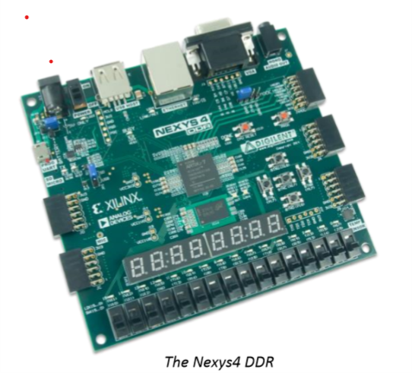
Nexys4 DDR board(Artix-7™ Field Programmable Gate Array (FPGA) from Xilinx)

Slide 12
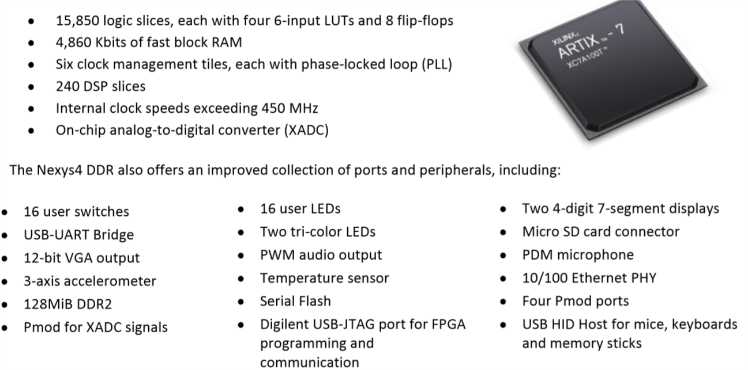

Slide 13
Hardware Description Language
VHDL ( Very high speed integrated circuit hardware description language)
Verilog

Slide 14
Introduction to VHDL
In the 1980s,rapid advances in integrated circuit technology
industry standard language for describing digital circuits
1987 and called IEEE 1076
1993 and called IEEE 1164
the initial description of the circuit in the form of VHDL code
VHDL compiler translates this code into a logic circuit
integers or characters, data objects in VHDL can be of various types.
BIT , 0 or 1

Slide 15
VHDL architecture
library ieee;
use ieee.std_logic_1164.all;
use ieee.numeric_std.all;
entity example is
port(
-
-
-
);
end example;
architecture logic_function of example is
begin
-
-
-
end logic_function;

Slide 16
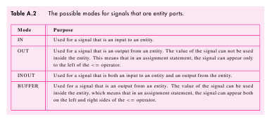
The input and output signals in an entity are speciﬁed using the ENTITY declaration
An ARCHITECTURE provides the circuit details for an entity.

Slide 17
Documentation in VHDL Code
VHDL compiler ignores any text on a line after the ‘- -’.
--This is our test circuit

Slide 18
Data Objects
Three kinds of data objects are provided: signals, constants, and variables.
Data Object Names
any alphanumeric character including ‘-’
legal names are x, x1, x_y, and Byte.
examples of illegal names are 1x,_y, x__y, and entity.
VHDL is not case sensitive. Hence x is the same as X,

Slide 19
Data Object Values and Numbers
SIGNAL data objects to represent individual logic signals in a circuit, multiple logic signals, and binary numbers (integers).
The value of a multibit SIGNAL is given with double quotes.
Example:”0001’, :10101011”
Integers, not using quotes

Slide 20
SIGNAL Data Objects
SIGNAL ,represent the logic signals, or wires, in a circuit.
SIGNAL signal_name : type_name ;
10 signal types:
BIT,
BIT_VECTOR,
STD_LOGIC,
STD_LOGIC_VECTOR,
STD_ULOGIC,
SIGNED,
UNSIGNED,
INTEGER,
ENUMERATION,
and BOOLEAN.
SIGNAL x1 : BIT;
SIGNAL C : BIT_VECTOR (1 TO 4) ;
SIGNAL Byte : BIT_VECTOR (7 DOWNTO 0) ;

Slide 21
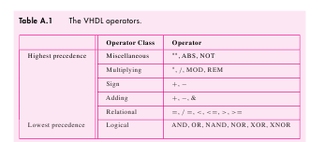
VHDL operators (page 787)

Slide 22
Example 1
f= ab
library IEEE;
use IEEE.STD_LOGIC_1164.ALL;
entity eg1 is
( a,b: in std_logic;
f: out std_logic
);
end eg1;
architecture logic_function of eg1 is
begin
f<= a and b;
end logic_function;

